Slide 1

HR Employees Analysis

Slide 2
About the Project
HR plays a key role in developing, reinforcing and changing the culture of an organisation. Pay, performance management, training and development, recruitment and onboarding and reinforcing the values of the business are all essential elements of business culture covered by HR. So, HR should remain up-to-date with all related and necessary information. The objective of this project is to analyse the data and create a dashboard which can be used by HR to get useful insights related to departments and employees.

Slide 3
About the Data
The dataset contains various attributes which gives information about the Managers, Source of Hires, Departments, Employee’s Position and many other attributes. The brief info about all columns present in the dataset is :
Employee Name : Employee’s full name

Slide 4
EmpID : Employee ID is unique to each employe
MarriedID : Is the person married (1 or 0 for yes or no)
MaritalStatusID : Marital status code that matches the text field MaritalDesc
EmpStatusID : Employment status code that matches text field EmploymentStatus

Slide 5
DeptID : Department ID code that matches the department the employee works in
PerfScoreID : Performance Score code that matches the employee’s most recent performance score
FromDiversityJobFairID : Was the employee sourced from the Diversity job fair? 1 or 0 for yes or no
Salary : The person’s annual pay rate.
Termd : Has this employee been terminated - 1 or 0

Slide 6
PositionID : An integer indicating the person’s position
Position : The text name/title of the position the person has
State : The state that the person lives in
Zip : The zip code for the employee
DOB : Date of Birth for the employee
Sex : Sex - M or F
MaritalDesc : The marital status of the person (divorced, single, widowed, separated, etc)

Slide 7

CitizenDesc : Label for whether the person is a Citizen or Eligible NonCitizen
HispanicLatino : Yes or No field for whether the employee is Hispanic/Latino
RaceDesc : Description/text of the race the person identifies with
DateofHire : Date the person was hired
DateofTermination : Date the person was terminated, only populated if, in fact, Termd = 1

Slide 8
TermReason : A text reason / description for why the person was terminated
EmploymentStatus : A description/category of the person’s employment status. Anyone currently working full time = Active
Department : Name of the department that the person works in
ManagerName : The name of the person’s immediate manager

Slide 9
ManagerID : A unique identifier for each manager.
RecruitmentSource : The name of the recruitment source where the employee was recruited from
PerformanceScore : Performance Score text/category (Fully Meets, Partially Meets, PIP, Exceeds)
EngagementSurvey : Results from the last engagement survey, managed by our external partner

Slide 10
EmpSatisfaction : A basic satisfaction score between 1 and 5, as reported on a recent employee satisfaction survey
SpecialProjectsCount : The number of special projects that the employee worked on during the last 6 months
LastPerformanceReviewDate : The most recent date of the person’s last performance review.
DaysLateLast30 : The number of times that the employee was late to work during the last 30 days

Slide 11
KPIs
Department and Position with most number of employees
Department whose employees are most satisfied and least satisfied
Department-wise and Position-wise Average Salary

Slide 12
Visual Analytics and Insights
In year 2011, attrition rate was highest (227%) because out of 83 hired people, 59 left the job whereas In year 2014, 60 new people joined and only 7 people left the company.
Jack Torrence is the most experienced and oldest employee of the company with experience of 13 years and works in Sales Department.

Slide 13
Janet King is the highest paid employee and works on the post of President and CEO.
Production Department has highest number of employees(125) and majority of them works as Production Technician(116).
From Total Annual Salary Expanses of $15M, top 5 employees take share of $1M.
Employees of Software Engineering Department are most satisfied and Employees of Executive Department are least satisfied.

Slide 14
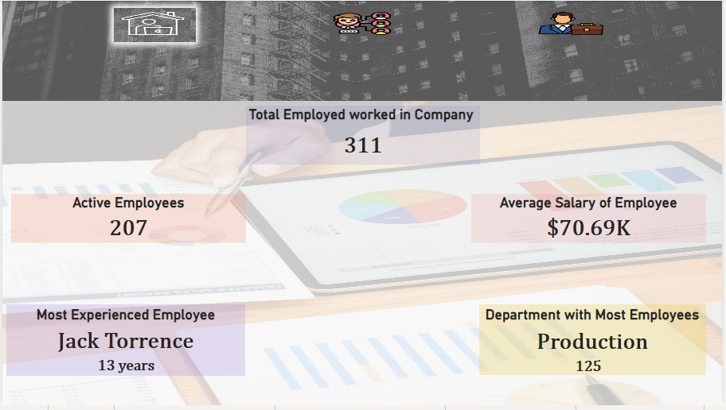
Dashboards

Slide 15
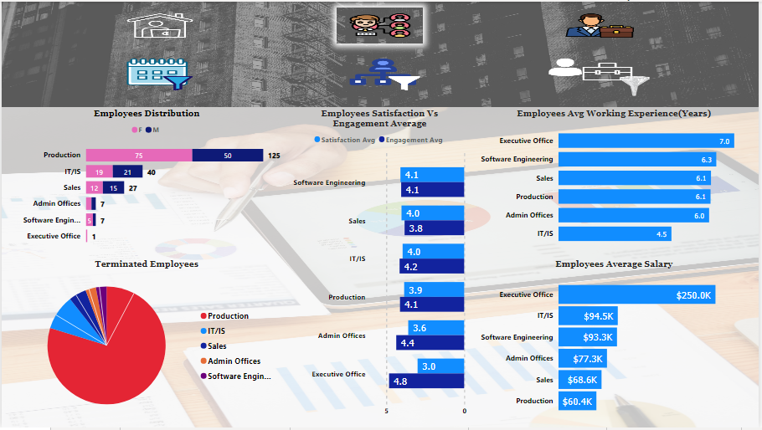

Slide 16
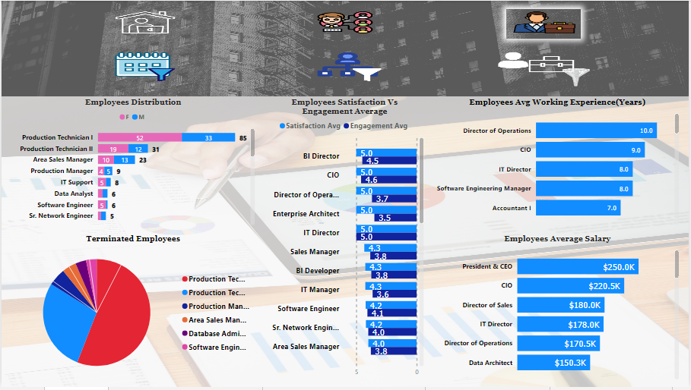

Slide 17
Thank you
Presentation by : Amit Sangwan

